Slide 1
RESOURCES - there are MANY
Recordings
Lecture Worksheets
Discussion Slides + Code
Review Quizzes
Go over midterm 1 & midterm 2
Look over PAs (submit to PRACTICE_ONLY versions to fix mistakes)
Create your own practice examples!

Slide 2
Final Review
REMEMBER: These will be very helpful BUT you still need to do additional studying on your own!!!

Slide 3
OUTLINE: click on a link to jump to a section
Java
Java Review
Interfaces
Generics
Data Structures
ArrayLists
Circular ArrayLists
LinkedLists
Doubly LinkedLists
Stacks & Queues
Maps & HashTables
BSTs
Heaps
Algorithms
BFS & DFS
Sorting
Time Complexity
Runtime
Notes:
Java Review
JUnit
Interfaces
Generics
Exceptions
ArrayLists
Circular ArrayLists
LinkedLists
Doubly LinkedLists
Stacks
Queues
BFS
DFS
Runtime
Measuring Runtime
Sorting
Maps & HashTables
BSTs
Heaps
C
Valgrind
Iterators
Summary of Data Structures
Review Quizzes
Midterm 1
Midterm 2

Slide 4
Java

Slide 5
Java Review

Slide 6
What is wrong with the below snippet of code?
String a = “aaa”
String b = “bbb”
if (a.compareTo(b)) {System.out.print(“WHOO”);

Slide 7
What is wrong with the below snippet of code?
compareTo returns an integer, NOT a boolean value
String a = “aaa”
String b = “bbb”
if (a.compareTo(b)) {System.out.print(“WHOO”);

Slide 8
What is wrong with the below snippet of code?
int compareValues(String a, String b) {
if (a.compareTo(b) > 0) { return 1; }
}

Slide 9
What is wrong with the below snippet of code?
int compareValues(String a, String b) {
if (a.compareTo(b) > 0) { return 1; }
}
Error: missing return statement
The if statement may not be entered. There needs to be a return statement at the end of the method

Slide 10
FILL IN THE BLANK
int compareValues(String a, String b) {
if (a.compareTo(b) > 0) { return 1; }
return 0;
}
compareValues(“a block”, “a black bear”) returns ______
compareValues(“11”, “12”) returns ______
compareValues(“I love CSE”, “I love CSE 12”) returns ______
compareValues(“San Diego”, “San Francisco”) returns ______

Slide 11
FILL IN THE BLANK
int compareValues(String a, String b) {
if (a.compareTo(b) > 0) { return 1; }
return 0;
}
compareValues(“a block”, “a black bear”) returns 1
compareValues(“11”, “12”) returns 0
compareValues(“I love CSE”, “I love CSE 12”) returns 0
compareValues(“San Diego”, “San Francisco”) returns 0

Slide 12
FILL IN THE BLANK
Fields with the modifier final are assigned _______ in the _______
Static fields are stored on the _______
Non-Static fields are stored on the _______
Variables are stored on the _______

Slide 13
FILL IN THE BLANK
Fields with the modifier final are assigned once in the constructor
Static fields are stored on the heap
Non-Static fields are stored on the heap
Variables are stored on the stack

Slide 14
FILL IN THE BLANK
_______ update example: c1 = c2 (c1 and c2 are both objects)
_______ update example: c2.color = “blue”
Both field and variable updates change only _______ value
_______ updates: update ONE variable on the STACK
_______ updates: update ONE field on the HEAP

Slide 15
FILL IN THE BLANK
Variable update example: c1 = c2 (c1 and c2 are both objects)
Field update example: c2.color = “blue”
Both field and variable updates change only ONE value
Variable updates: update ONE variable on the STACK
Field updates: update ONE field on the HEAP

Slide 16
What does Q2 print?
public class Q2 {
public static void f(Coord c) {
Car car = new Car("blue", c);
car.location.row = 10;
car.location.col = 9;
}
public static int question() {
Coord unit = new Coord(1, 1);
Car blackCar = new Car("black", unit);
f(unit);
return blackCar.location.row;
}
public static void main(String[] args) {
System.out.println(question());
}
}
returns:
@Z | [] An empty array for args, a detail not used in this example
A: 1
B: 0
C: 9
D: 10
E: Something else
returns:
Q1.main(@Z)
args | @Z
returns: nothing (void)

Slide 17
What does Q2 print?
public class Q2 {
public static void f(Coord c) {
Car car = new Car("blue", c);
car.location.row = 10;
car.location.col = 9;
}
public static int question() {
Coord unit = new Coord(1, 1);
Car blackCar = new Car("black", unit);
f(unit);
return blackCar.location.row;
}
public static void main(String[] args) {
System.out.println(question());
}
}
Q2.f(@A)
c | @A
car | @C
returns: void
@A | Coord row 10 col 9
@B | Car color “black” location @A
@C | Car color “blue” location @A
@Z | [] An empty array for args, a detail not used in this example
A: 1
B: 0
C: 9
D: 10
E: Something else
Q2.question()
unit | @A
blackCar | @B
returns: 10
Q2.main(@Z)
args | @Z
returns: nothing (void)
Q1.main(@Z)
args | @Z
returns: nothing (void)

Slide 18
How long do changes persist after a method ends?
Changes on the heap last forever, never automatically undone, stays until a field update changes it again, if you want to have the behavior of changing a field and reverting it back you must implement it

Slide 19
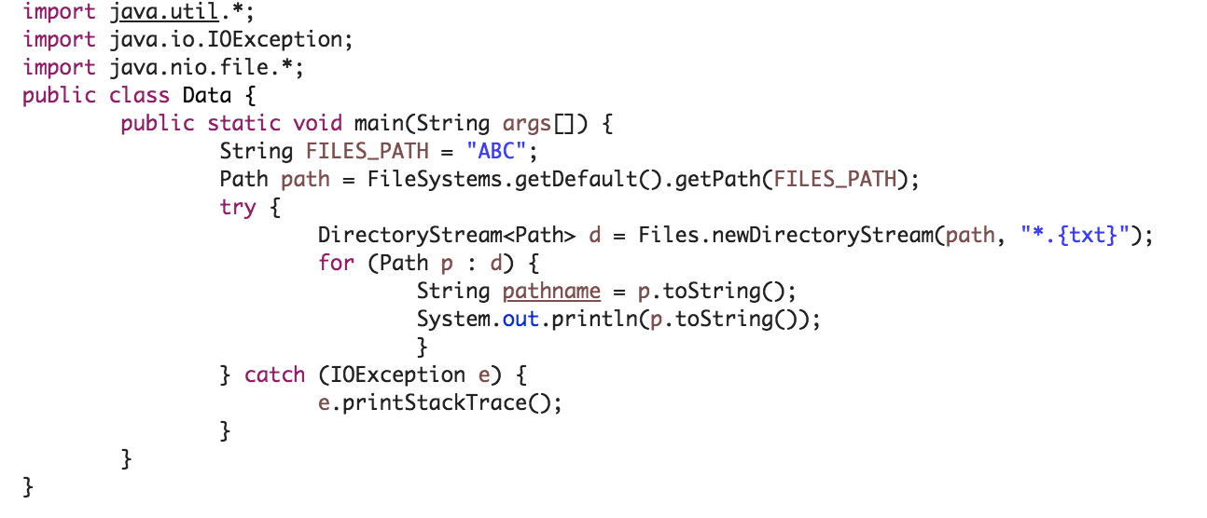
What will be the output?
A : NoSuchFileException
B : NotDirectoryException
C : No exceptions will occur
D : It will print ABC/ABC.txt ABC/DEF.txt

Slide 20
What will be the output?
A : NoSuchFileException
B : NotDirectoryException
C : No exceptions will occur
D : It will print ABC/ABC.txt ABC/DEF.txt

Slide 21
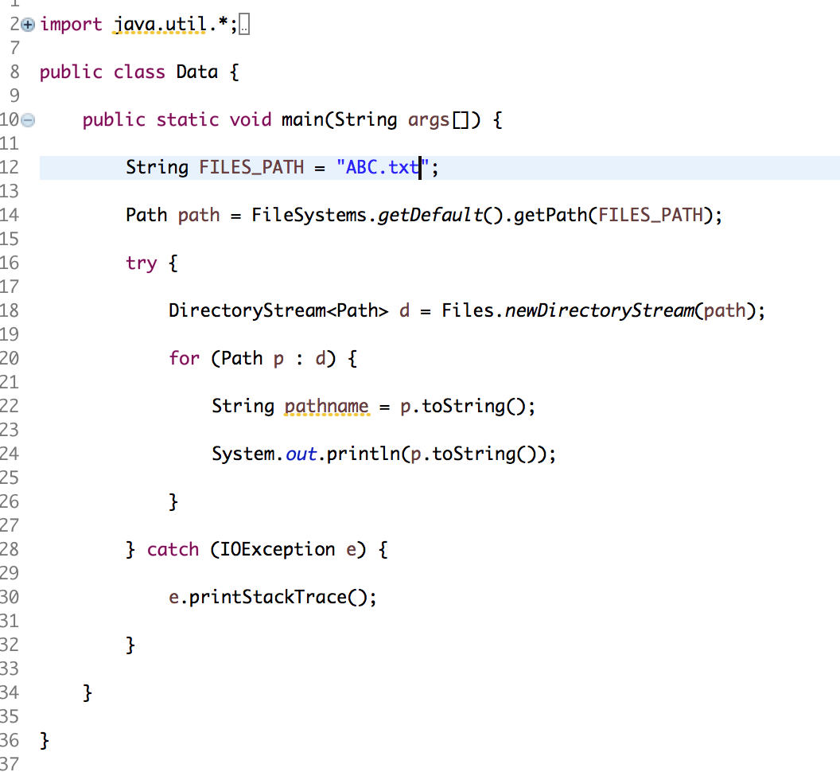
What will be the output?
A : NoSuchFileException
B : NotDirectoryException
C : No exceptions will occur
D : It will print ABC/ABC.txt ABC/DEF.txt

Slide 22
What will be the output?
A : NoSuchFileException
B : NotDirectoryException
C : No exceptions will occur
D : It will print ABC/ABC.txt ABC/DEF.txt

Slide 23
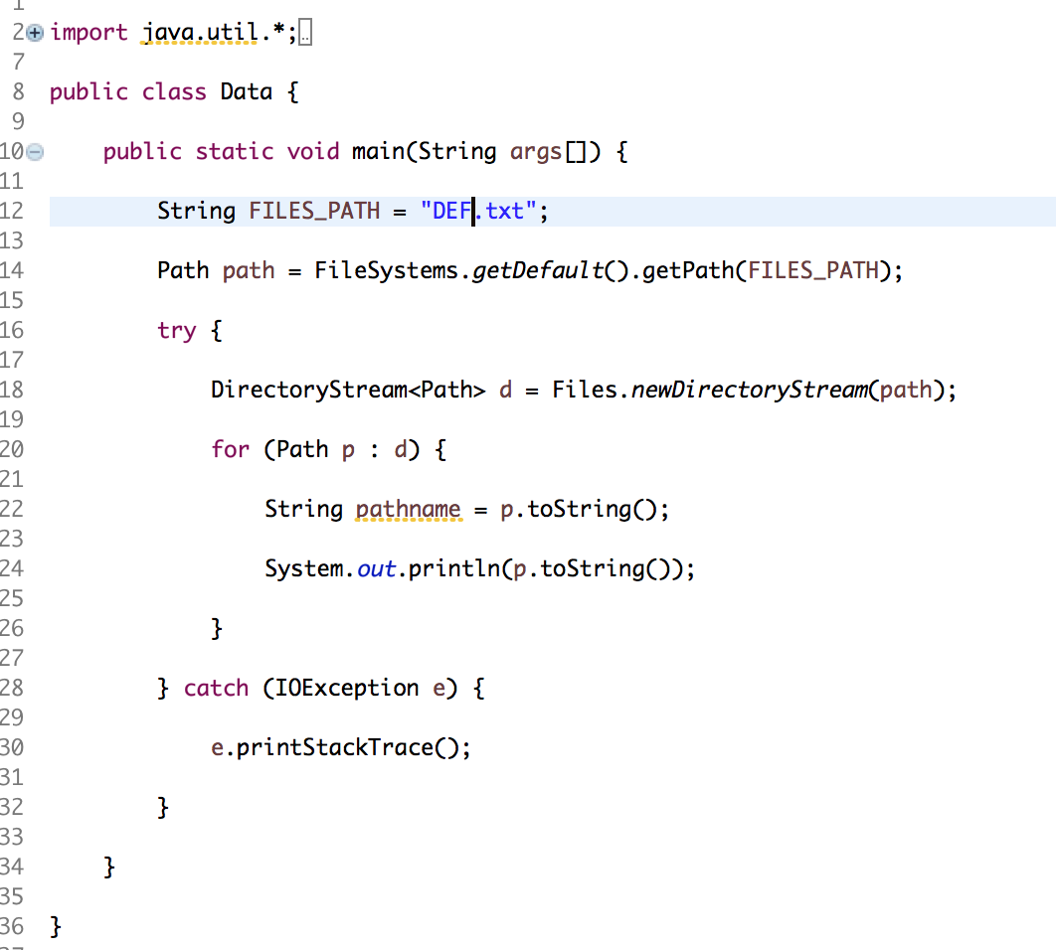
What will be the output?
A : NoSuchFileException
B : NotDirectoryException
C : No exceptions will occur
D : It will print ABC/ABC.txt ABC/DEF.txt

Slide 24
What will be the output?
A : NoSuchFileException
B : NotDirectoryException
C : No exceptions will occur
D : It will print ABC/ABC.txt ABC/DEF.txt

Slide 25
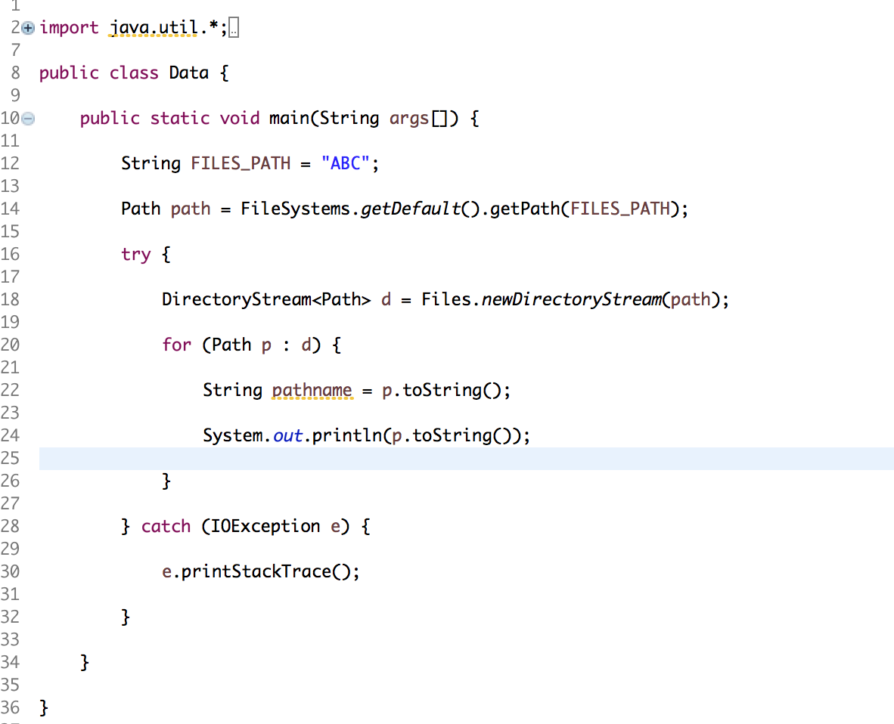
What will be the output?
A : NoSuchFileException
B : NotDirectoryException
C : It will print ABC/ABC.txt ABC/DEF.txt
D : It will print ABC/ABC.txt ABC/DEF.txt ABC/download.png

Slide 26
What will be the output?
A : NoSuchFileException
B : NotDirectoryException
C : It will print ABC/ABC.txt ABC/DEF.txt
D : It will print ABC/ABC.txt ABC/DEF.txt ABC/download.png

Slide 27
Interfaces

Slide 28
FILL IN THE BLANK
An interface...
Contains _____ and _____ _____ only. Classes implementing the interface must override and define these methods.
To define, use keyword “_____”.
To implement, use keyword “_____”.
Allows code reuse by having multiple classes that share a type (subtype _____).

Slide 29
FILL IN THE BLANK
An interface...
Contains fields and method signatures only. Classes implementing the interface must override and define these methods.
To define, use keyword “interface”.
To implement, use keyword “implements”.
Allows code reuse by having multiple classes that share a type (subtype polymorphism).

Slide 30
Which one of the lines below will result in a compile error?
Student s1 = new Student(“Andrew”)
User u1 = new Student(“Jane”);
Student s2 = new User(“Rachel”);

Slide 31
Which one of the lines below will result in a compile error?
An interface cannot be initialized on its own. Interfaces are utilized by implementing them through other concrete classes. So you cannot initialize User since it is an interface.
Student s1 = new Student(“Andrew”)
User u1 = new Student(“Jane”);
Student s2 = new User(“Rachel”);

Slide 32
Collection Interface
The Collection interface is the foundation upon which the collections framework is built.
It declares the core methods that all collections will have.

Slide 33
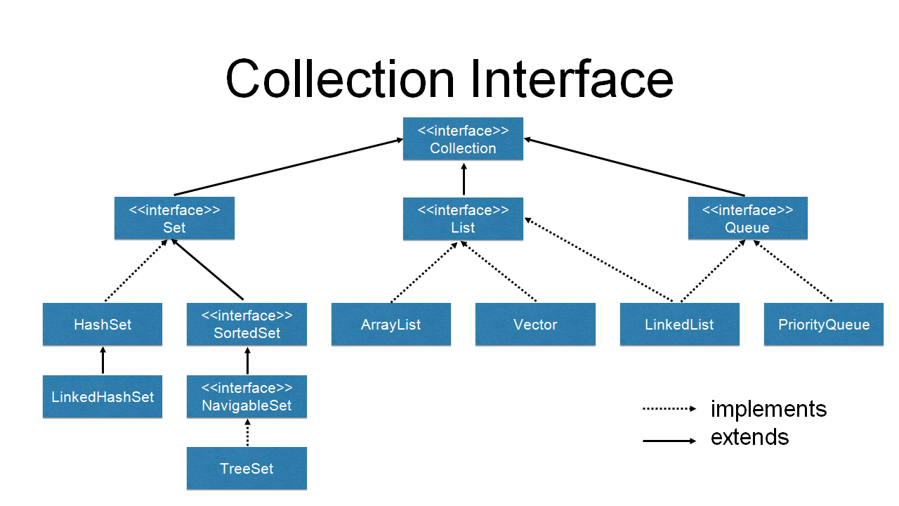

Slide 34
What all can we do with Collection?
There are a few basic operations you'll normally use with collections:
Add objects to the collection
Remove objects from the collection
Find out if an object (or group of objects) is in the collection
Retrieve an object from the collection (without removing it)
Iterate through the collection, looking at each element (object) one after another

Slide 35
Collections Class
This class consists exclusively of static methods that operate on or return collections.
Java Collection class throws a NullPointerException if the collections or class objects provided to them are null.

Slide 36
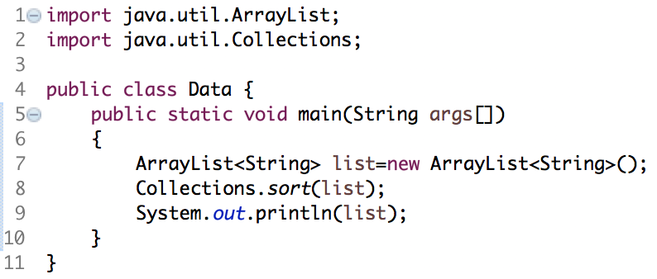
What will be the output?
NullPointerException at line 8
NullPointerException at line 9
[]
[null]

Slide 37
What will be the output?
NullPointerException at line 8
NullPointerException at line 9
[]
[null]

Slide 38
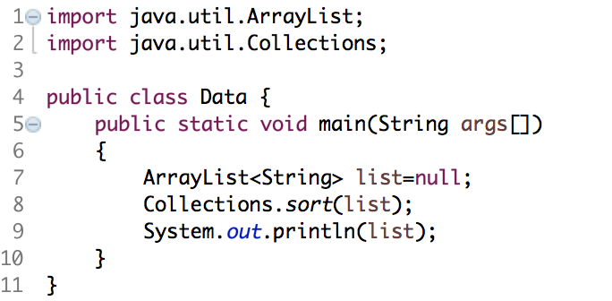
What will be the output?
NullPointerException at line 8
NullPointerException at line 9
[]
[null]

Slide 39
What will be the output?
NullPointerException at line 8
NullPointerException at line 9
[]
[null]

Slide 40
Collections Class v/s Collection Interface
Collections is a class, with static utility methods
Collection is an interface with declarations of the methods common to most collections including add(), remove(), size() and iterator().

Slide 41
Collections.sort()

Slide 42
Collections.sort() in Java
java.util.Collections.sort() method is present in java.util.Collections class.
It is used to sort the elements present in the specified list of Collection in ascending order.
Structure:
public static void sort(List myList)
myList : A List type object we want to sort.
This method doesn't return anything

Slide 43
What will be the output?
import java.util.ArrayList;
import java.util.Collections;
public class Data {
public static void main(String args[])
{
ArrayList<String> list=new ArrayList<String>();
ArrayList<String> newList=new ArrayList<String>();
list.add("Kevin");
list.add("Emily");
list.add("edward");
list.add("Kim");
newList = Collections.sort(list);
System.out.println(newList);
}
}
[edward, Emily, Kevin, Kim]
[Emily, edward, Kevin, Kim]
Runtime Exception
Compile Time Error

Slide 44
What will be the output?
import java.util.ArrayList;
import java.util.Collections;
public class Data {
public static void main(String args[])
{
ArrayList<String> list=new ArrayList<String>();
ArrayList<String> newList=new ArrayList<String>();
list.add("Kevin");
list.add("Emily");
list.add("edward");
list.add("Kim");
newList = Collections.sort(list);
System.out.println(newList);
}
}
[edward, Emily, Kevin, Kim]
[Emily, edward, Kevin, Kim]
Runtime Exception
Compile Time Error

Slide 45
Collections.sort() in Java
Java provides two interfaces to sort objects using data members of the class:
Comparable
Comparator

Slide 46
Using Comparable Interface
A comparable object is capable of comparing itself with another object.
The class itself must implements the java.lang.Comparable interface to compare its instances.
Basically, a list can be sorted if only all of its elements are mutually comparable by implementing the Comparable interface. If a class implements the Comparable interface, it is considered as having natural ordering which allows objects of that class to be sorted by the Collections.sort(list) method.
All basic data type wrapper classes in Java have natural ordering: String, Character, Byte, Date, Integer, Float, etc.
Basically, a list can be sorted if only all of its elements are mutually comparable by implementing the Comparable interface.
If a class implements the Comparable interface, it is considered as having natural ordering which allows objects of that class to be sorted by the Collections.sort(list) method.
All basic data type wrapper classes in Java have natural ordering: String, Character, Byte, Date, Integer, Float, etc. Here are some examples:

Slide 47
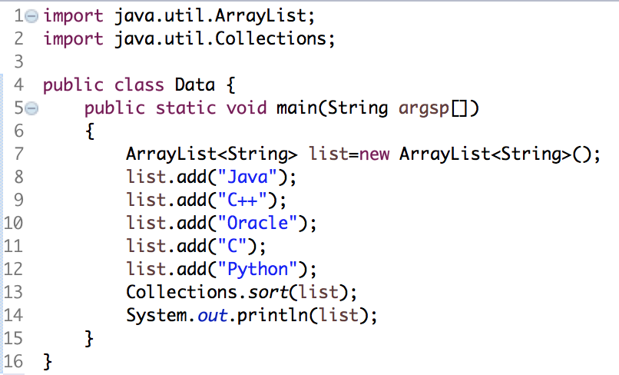

A simple example
Output:

Slide 48
Using Comparator Interface
Unlike Comparable, Comparator is external to the element type we are comparing.
It’s a separate class.

Slide 49
Using Comparator Interface
We have to override the following function:
int compare(T obj1, T obj 2)
Compares its two arguments for order.
Returns a negative integer, zero, or a positive integer as the first argument is less than, equal to, or greater than the second.

Slide 50
Using Comparator Interface
We create multiple separate classes (that implement Comparator) to compare by different members.
Collections class has a sort() method that takes Comparator as an input.
The sort() method invokes the compare() to sort objects.

Slide 51
Example:
Consider a Movie class that has members like, rating, name, year.
Suppose we wish to sort a list of Movies based on rating.
To compare movies by Rating, we need to do 3 things :
Create a class that implements Comparator (and thus the compare() method)
Make an instance of the Comparator class.
Call the sort() method, giving it both the list and the instance of the class that implements Comparator.

Slide 52
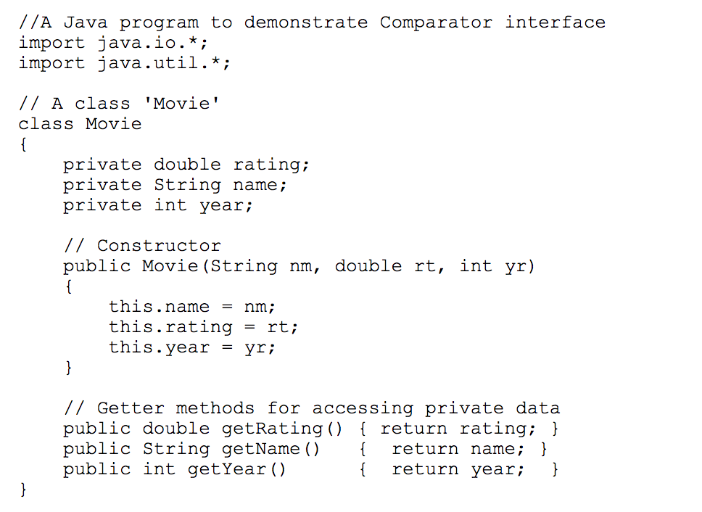

Slide 53
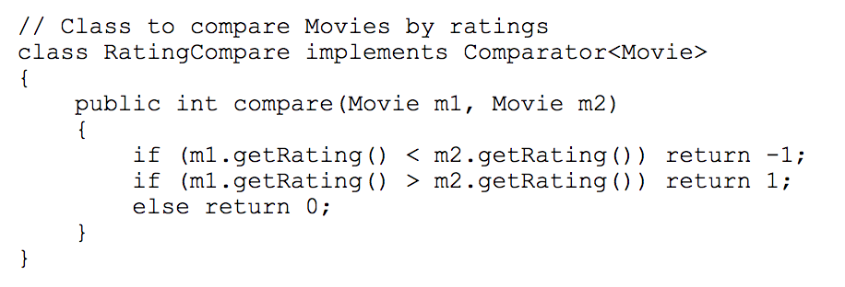

Slide 54
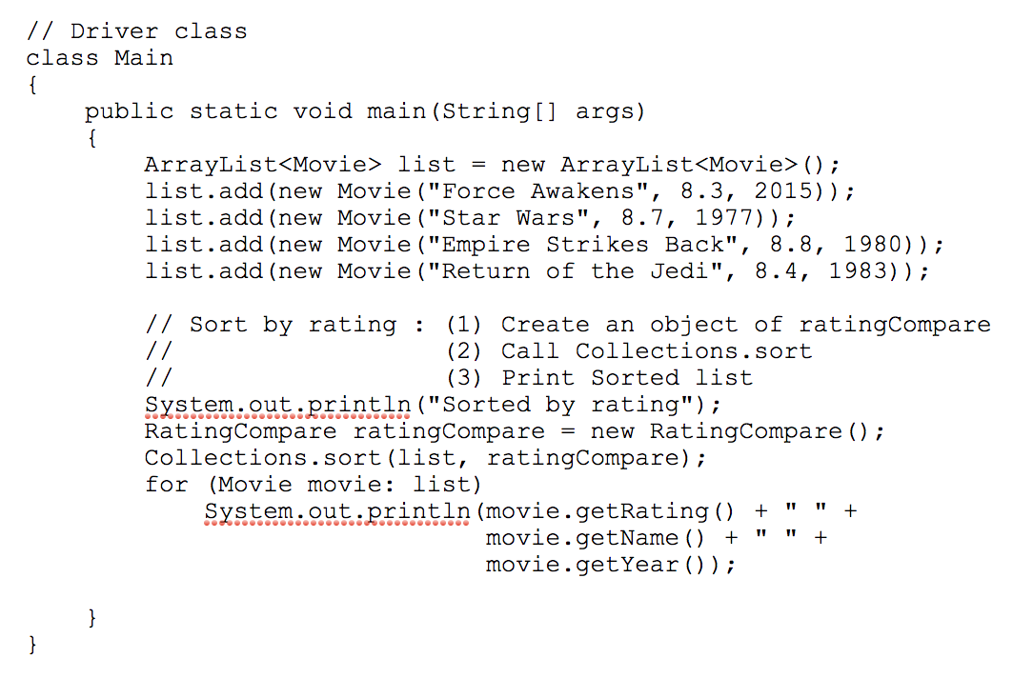

Slide 55
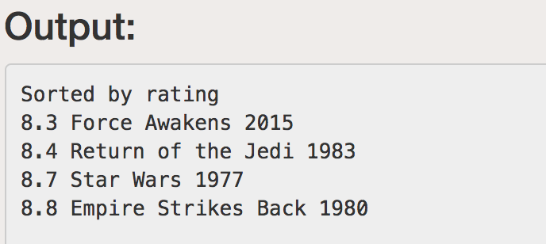

Slide 56
Generics

Slide 57
Instantiation
Given the following code, which of the instantiations in main are valid?
public interface MyInterface<A, B>{ void print(); } public class MyClass<A, B> implements MyInterface<A, B>{ int num = 0; void print(){ System.out.println("Hi"); } public class Node{ int num = 0; } public static void main(String[] args){ MyInterface<A, B> obj = new MyClass<A, B>(); //will this work? MyInterface<int, String> obj = new MyClass<int, String>(); //will this work? MyInterface<String, String> obj = new MyClass<>(); //will this work? MyInterface<> obj = new MyClass<Node, Node>(); //will this work? } }

Slide 58
Instantiation
Given the following code, which of the instantiations in main are valid?
public interface MyInterface<A, B>{ void print(); } public class MyClass<A, B> implements MyInterface<A, B>{ int num = 0; void print(){ System.out.println("Hi"); } public class Node{ int num = 0; } public static void main(String[] args){ MyInterface<A, B> obj = new MyClass<A, B>(); MyInterface<int, String> obj = new MyClass<int, String>(); MyInterface<String, String> obj = new MyClass<>(); //only this one! MyInterface<> obj = new MyClass<Node, Node>(); } }

Slide 59
FILL IN THE BLANK
Multiple classes may be nearly identical, differing only in their data types they contain…
Generics allow us to implement classes without limiting the _______ that we can store in the class
RULE TO FOLLOW: outermost type should be a _______, it needs to be instantiated. Inside of angled brackets use _______.

Slide 60
FILL IN THE BLANK
Multiple classes may be nearly identical, differing only in their data types they contain…
Generics allow us to implement classes without limiting the data type that we can store in the class
RULE TO FOLLOW: outermost type should be a class, it needs to be instantiated. Inside of angled brackets use interface.

Slide 61
What is wrong with the below snippet of code? (Assume you have access to all variables used in the method)
private void expandCapacity() {
E[] expanded = (E[])(new Object[this.size * 2]);
}

Slide 62
What is wrong with the below snippet of code? (Assume you have access to all variables used in the method)
@SuppressWarnings(“unchecked”)
private void expandCapacity() {
E[] expanded = (E[])(new Object[this.size * 2]);
}

Slide 63
Data Structures

Slide 64
Array Lists (AL)

Slide 65
FILL IN THE BLANK
________ represents how many elements have been added
________ represents how much space we have in an array
To add String s into an AList, add String s at the specified ________ in the AList and shift all subsequent elements to the ________ by ________ index
To remove a String s at the specified index in the AList, remove String s at the specified ________ and shift all subsequent elements to the ________ by ________ index

Slide 66
FILL IN THE BLANK
Size represents how many elements have been added
Capacity represents how much space we have in an array
To add String s into an AList, add String s at the specified index in the AList and shift all subsequent elements to the right by one index
To remove a String s at the specified index in the AList, remove String s at the specified index and shift all subsequent elements to the left by one index

Slide 67
True or False
In a class, can a method and field have the same name.

Slide 68
True or False
In a class, can a method and field have the same name. (TRUE)

Slide 69
FILL IN THE BLANK
If there is an ArrayList with 3 elements in it and its capacity starts at 3 and its capacity increases by a factor of 3 during each resize
The capacity after inserting 7 elements will be _______
The capacity after inserting 9 elements will be _______
The capacity after inserting 12 elements will be _______

Slide 70
FILL IN THE BLANK
If there is an ArrayList with 3 elements in it and its capacity starts at 3 and its capacity increases by a factor of 3 during each resize
The capacity after inserting 7 elements will be 27
The capacity after inserting 9 elements will be 27
The capacity after inserting 12 elements will be 27

Slide 71
Summary: ArrayList (AL) (Unsorted, using SLL or Array)
Method | Worst Case | Best Case
find | O(______) | O(______)
insert | O(______) | O(______)
remove | O(______) | O(______)

Slide 72
Summary: ArrayList (AL) (Unsorted, using SLL or Array)
Method | Worst Case | Best Case
find | O(n) | O(1)
insert | O(n) | O(1)
remove | O(n), | O(1)

Slide 73
Summary: ArrayList (AL) (Sorted, using Array)
Method | Worst Case | Best Case
find | O(______) | O(______)
insert | O(______) | O(______)
remove | O(______) | O(______)

Slide 74
Summary: ArrayList (AL) (Sorted, using Array)
Method | Worst Case | Best Case
find | O(logn) - perform binary search | O(1)
insert | O(n) | O(1)
remove | O(n) | O(1)

Slide 75
Circular Array Lists

Slide 76
Summary: CircularArrayList (AL) Unsorted
Method | Worst Case | Best Case
find | O(______) | O(______)
insert | O(______) | O(______)
remove | O(______) | O(______)
get | O(______) | O(______)
add | O(______) | O(______)
prepend | O(______) | O(______)

Slide 77
Summary: CircularArrayList (AL) Unsorted
Method | Worst Case | Best Case
find | O(n) | O(1)
insert | O(n) | O(1)
remove | O(n) | O(1)
get | O(1) | O(1)
add | O(n) | O(1)
prepend | O(n) | O(1)

Slide 78
Singly Linked Lists

Slide 79
FILL IN THE BLANK
The method add() adds an element to the ______ of the list
The method prepend() adds an element to the ______ of the list

Slide 80
FILL IN THE BLANK
The method add() adds an element to the end of the list
The method prepend() adds an element to the front of the list

Slide 81
Runtime of operations on lists
Worst case analysis of operations on ArrayList and SinglyLinkedList
 | ArrayList | SinglyLinkedList
get (an index) | O(______) | O(______)
find (a value) | O(______) | O(______)
insert at beg / prepend | O(______) | O(______)
insert at end / append | O(______) | O(______)
delete | O(______) | O(______)

Slide 82
Runtime of operations on lists
Worst case analysis of operations on ArrayList and SinglyLinkedList
 | ArrayList | SinglyLinkedList
get (an index) | O(1) | O(n)
find (a value) | O(n) | O(n)
insert at beg / prepend | O(n) | O(1)
insert at end / append | O(n) | O(n)
delete | O(n) | O(n)

Slide 83
Runtime of operations on lists
Best case analysis of operations on ArrayList and SinglyLinkedList
 | ArrayList | SinglyLinkedList
get / find | O(______) | O(______)
insert at beg / prepend | O(______) | O(______)
insert at end / append | O(______) | O(______)
delete | O(______) | O(______)

Slide 84
Runtime of operations on lists
Best case analysis of operations on ArrayList and SinglyLinkedList
 | ArrayList | SinglyLinkedList
get / find | O(1) | O(1)
insert at beg / prepend | O(n) | O(1)
insert at end / append | O(1) | O(n)
delete | O(1) | O(1)

Slide 85
Doubly Linked Lists

Slide 86
What is the difference between a doubly and singly LinkedList?

Slide 87
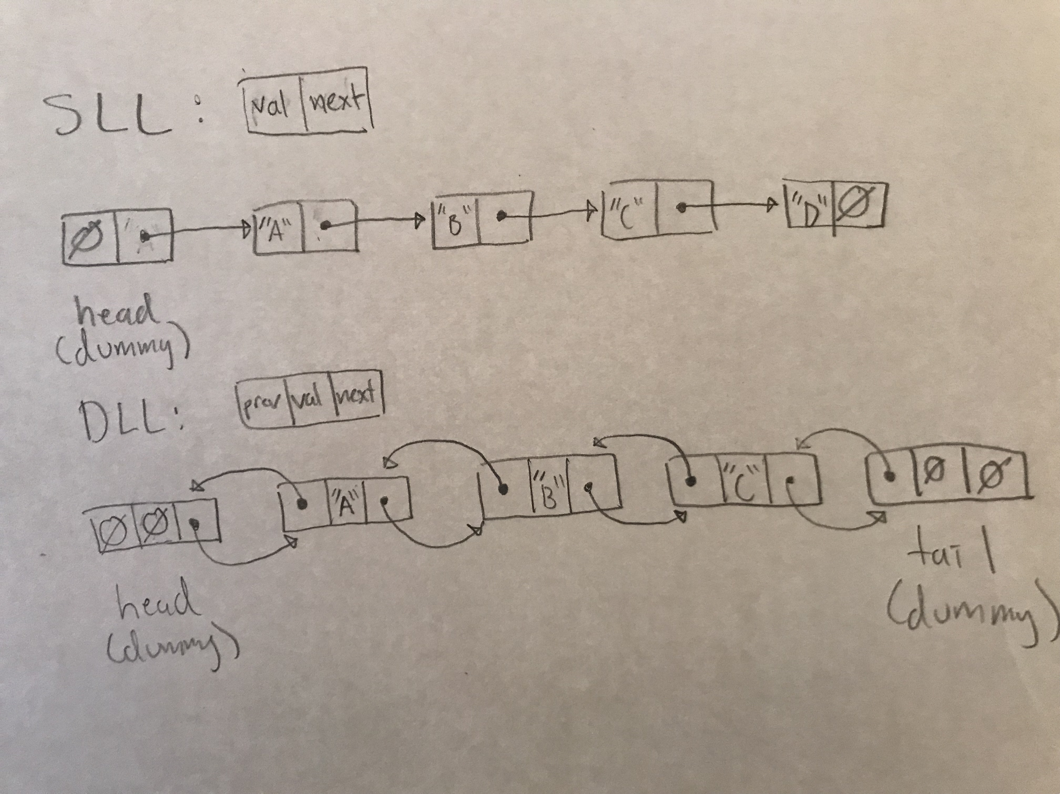
What is the difference between a doubly and singly LinkedList?
Doubly LinkedLists have the fields head AND tail. Each node contains next AND prev.
Singly LinkedLists only contain the field head and each nodes ONLY contain next.

Slide 88
Summary: Doubly Linked List
 | Best Case | Worst Case
get / find | O(______) | O(______)
prepend | O(______) | O(______)
append | O(______) | O(______)
delete (a given node) | O(______) | O(______)

Slide 89
Summary: Doubly Linked List
 | Best Case | Worst Case
get / find | O(1) | O(n)
prepend | O(1) | O(1)
append | O(1) | O(1)
delete (a given node) | O(1) | O(1)
delete (a given index or value) | O(1) | O(n)

Slide 90
Stacks & Queues

Slide 91
FILL IN THE BLANK
______ have the property LIFO (last in, first out)
______ have the property FIFO (first in, first out)
Basic methods for a stack include: ______, ______
Basic methods for a queue include: ______, ______

Slide 92
FILL IN THE BLANK
Stacks have the property LIFO (last in, first out)
Queues have the property FIFO (first in, first out)
Basic methods for a stack include: push, pop
Basic methods for a queue include: enqueue, dequeue

Slide 93
Summary: Stack (using a singly linked list)
 | Best Case | Worst Case
push | O(______) | O(______)
pop | O(______) | O(______)
peek | O(______) | O(______)

Slide 94
Summary: Stack (using a singly linked list)
 | Best Case | Worst Case
push | O(1) | O(1)
pop | O(1) | O(1)
peek | O(1) | O(1)

Slide 95
Summary: Queue (using a doubly linked list)
 | Best Case | Worst Case
enqueue | O(______) | O(______)
dequeue | O(______) | O(______)

Slide 96
Summary: Queue (using a doubly linked list)
 | Best Case | Worst Case
enqueue | O(1) | O(1)
dequeue | O(1) | O(1)

Slide 97
Maps & HashTables

Slide 98
FILL IN THE BLANK
______ is a data structure which implements an array-like data type to map keys to values.
Uses a ______ to compute an index into an array of buckets, where the desired key-value pair can be inserted and found.
A hash function assigns an ______ value to a ______ key.

Slide 99
FILL IN THE BLANK
hash table is a data structure which implements an array-like data type to map keys to values.
Uses a hash function to compute an index into an array of buckets, where the desired key-value pair can be inserted and found.
A hash function assigns an integer value to a specific key.

Slide 100
Is this a good hash function?
return s.length();

Slide 101
Is this a good hash function?
return s.length();
All strings of the same length will get mapped to the same bucket if the length of the string is < array size. So this is NOT a good hash function.
A good hash function is imperative to maintain efficiency in a hash table.

Slide 102
FILL IN THE BLANK
What is a good hash function?
Hash value is ______, i.e. it is determined fully by the data that is being hashed.
Uses ______ the input data (as much information as possible)
______ distributes data across the set of hash values. (uniqueness of hash values).
Note: ______ modulo the hash code with array size to get index.

Slide 103
FILL IN THE BLANK
What is a good hash function?
Hash value is deterministic, i.e. it is determined fully by the data that is being hashed.
Uses all the input data (as much information as possible)
Uniformly distributes data across the set of hash values. (uniqueness of hash values).
Note: Always modulo the hash code with array size to get index.

Slide 104
Load threshold & Expansion factor
Once the ratio: size (number of elements inserted) / array.size of a hash table exceeds or is equal to a certain load threshold, the array of buckets should expand by the expansion factor.
This is done in order to maintain efficiency of the hash table and expand range of potential hash values when table starts filling up. (To avoid collisions)

Slide 105
Rehashing
Rehash all existing elements in hashtable once the load threshold is reached and the array is expanded.
It is important to regenerate the index of the bucket of existing keys in the hashtable.
Same keys can be potentially mapped to different buckets due to change in array size.

Slide 106
What are collisions?
A collision occurs when a new key is inserted into a non-empty bucket.
Common misconception:
“Updating a key-value pair is a collision”. It is NOT! That is, if a bucket contains a key-value pair and the value of a certain key is replaced via insertion, this is NOT A COLLISION.

Slide 107
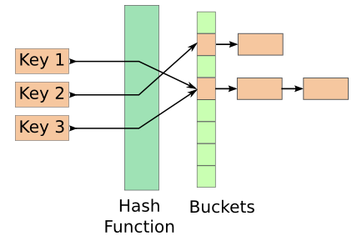
Separate Chaining
Each bucket stores a list of key-value pairs
Multiply keys mapped to the same bucket is maintained by this list

Slide 108
FILL IN THE BLANK
A bucket is a collection of ______ at a specific ______
The load factor is # ______ / # ______

Slide 109
FILL IN THE BLANK
A bucket is a collection of elements at a specific index
The load factor is # elements / # buckets

Slide 110
FILL IN THE BLANK
Assign a ______ to each ______ we are trying to keep track of.
Index for entry is determined by a ______ function that calculates index using key value (USEFUL FOR QUICK ______ AND ______)
Contains methods ______(Object key), ______(K key, V value), ______(), ______(K key, V value) etc.
Keys need to be ______
put() will essentially do what ______() does, however, ______() will not place a new entry as put() does

Slide 111
FILL IN THE BLANK
Assign a key to each value we are trying to keep track of.
Index for entry is determined by a hash function that calculates index using key value (USEFUL FOR QUICK LOOKUP AND INSERT)
Contains methods get(Object key), put(K key, V value), size(), replace(K key, V value) etc.
Keys need to be unique
put() will essentially do what replace() does, however, replace() will not place a new entry as put() does

Slide 112
Runtime of operations on Maps
 | Maps (best) | Maps (worst)
get / find | O(____) | O(____)
insert (prepend) | O(____) | O(____)
insert (append) | O(____) | O(____)
delete | O(____) | O(____)

Slide 113
Runtime of operations on Maps
 | Maps (best) | Maps (worst)
get / find | O(1) | O(n)
insert (prepend) | O(1) | O(n)
insert (append) | O(1) | O(n)
delete | O(1) | O(n)

Slide 114
HashTables
Method | Worst Case | Best Case
find | O(____) | O(____)
insert | O(____) | O(____)
remove | O(____) | O(____)

Slide 115
HashTables
Method | Worst Case | Best Case
find | O(n) | O(1)
insert | O(n) | O(1)
remove | O(n) | O(1)

Slide 116
Binary Search Trees
https://www.cs.usfca.edu/~galles/visualization/BST.html

Slide 117
FILL IN THE BLANK
If a new element is added (with a unique key) to a BST it will always be added at a ______ most node that has ______ as a left or right child
The height of a tree is the number of nodes on the ______ path from the root to the ______ (or to a ______).
The best case height for a tree with n elements is ______. The worst case height for a tree with n elements is ______

Slide 118
FILL IN THE BLANK
If a new element is added (with a unique key) to a BST it will always be added at a bottom most node that has null as a left or right child
The height of a tree is the number of nodes on the longest path from the root to the bottom (or to a leaf).
The best case height for a tree with n elements is lgn. The worst case height for a tree with n elements is n

Slide 119
BSTs
Method | Worst Case | Best Case
find | O(____) | O(____)
insert | O(____) | O(____)
remove | O(____) | O(____)

Slide 120
BSTs
Method | Worst Case | Best Case
find | O(n) | O(1)
insert | O(n) | O(1)
remove | O(n) | O(1)

Slide 121
FILL IN THE BLANK:
Definition: A tree is a _______ if every level but the last level is completely full, and the last level is filled starting from the leftmost node.

Slide 122
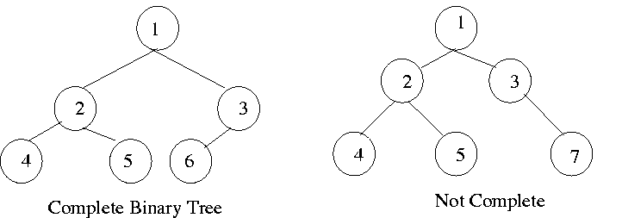
FILL IN THE BLANK:
Definition: A tree is a complete tree if every level but the last level is completely full, and the last level is filled starting from the leftmost node.

Slide 123
FILL IN THE BLANK:
Definition: A tree is a _______ if every node other than the leaves has two children

Slide 124
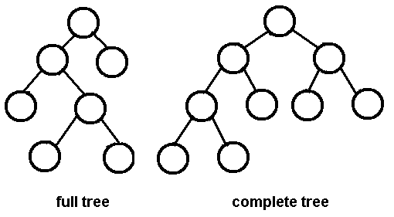
FILL IN THE BLANK:
Definition: A tree is a full tree if every node other than the leaves has two children

Slide 125
FILL IN THE BLANK:
Definition: A tree is a _______ if for each node, the left and right subtrees have levels that differ in height by at most 1

Slide 126
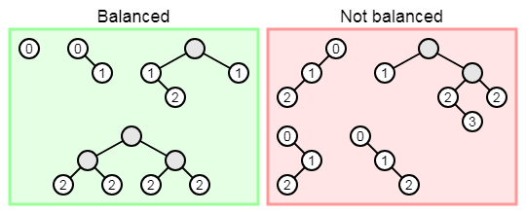
FILL IN THE BLANK:
Definition: A tree is a height-balanced tree if for each node, the left and right subtrees have levels that differ in height by at most 1

Slide 127
Heaps
https://www.cs.usfca.edu/~galles/visualization/Heap.html

Slide 128

HEAPS!!!
Min-Heap:
The value of each node is greater than or equal to the value of its parent, with the minimum-value element at the root.
Main operations:
removeMin, add
Important subroutines:
Bubble Up and Bubble Down
(Is actually a max heap)

Slide 129
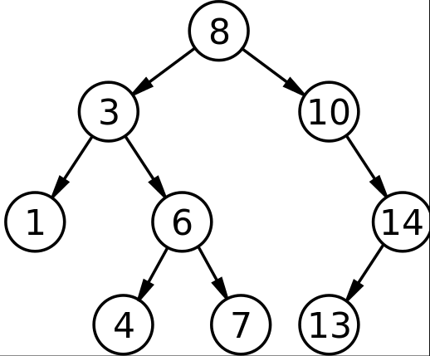
How is it different from a BST?
Min Heap:
Binary Tree with each parent’s value < its 2 children
Builds left to right
Max difference in height between any 2 leafs nodes = 1
BST:
Binary Tree with parent holding references to <=2 children
Follows an ordering among parents and children. Usually, to get a sorted result, you go
Left child -> Parent -> Right child
This means that Left child < Parent < Right Child
Are there other type of orderings possible….? (spoiler: yes)

Slide 130

Bubble Down
Occurs when removing an element from a Heap.
Save root value and copy last node into root (also decrease size)
Starting from root, recursively swap current node with the smaller of its children.
End recursion when leaf node is reached or children are larger than the parent.

Slide 131
Bubble Up
Occurs when adding an element to a Heap.
Recursively compare element with its parent and swap them if child < parent
End recursion when child >= parent, or when current node is root.
void bubbleUp(Heap* h, int index) {
if(index <= 0) { return; }
int parentIndex = (index - 1) / 2;
if(h->elements[parentIndex].key < h->elements[index].key) { return; }
swap(h, parentIndex, index);
bubbleUp(h, parentIndex);
}

Slide 132
What’s the point?
Worst case Add removeMin
Array | O(n) | O(n)
Linked List | O(n) | O(n)
 | O(log n) | O(log n)
Heap
Pros:
Implement other data structures (e.g. Priority Queues) faster
Is pretty cool
Can be used to implement Heapsort

Slide 133
FILL IN THE BLANK
Definition: A tree is a ______ if every level but the last level is completely full, and the last level is filled starting from the leftmost node.
Property: A complete tree's size and height are related by:
______ ~ ______
Definition: A tree is in ______ (______) ______ order if every node's key is greater (less) than or equal to all of its childrens' keys.
Definition: A max (min) heap is a ______ that is in max (min) heap order.

Slide 134
FILL IN THE BLANK
Definition: A tree is a complete tree if every level but the last level is completely full, and the last level is filled starting from the leftmost node.
Property: A complete tree's size and height are related by:
height ~ log(size)
Definition: A tree is in max (min) heap order if every node's key is greater (less) than or equal to all of its childrens' keys.
Definition: A max (min) heap is a complete tree that is in max (min) heap order.

Slide 135
FILL IN THE BLANK
Because we are using a complete tree poll() will be directly related to:
Θ(______) = Θ(______)
Because we are using a complete tree add(?) will be directly related to:
Θ(______) = Θ(______)

Slide 136
FILL IN THE BLANK
Because we are using a complete tree poll() will be directly related to:
Θ(height) = Θ(lg(size))
Because we are using a complete tree add(?) will be directly related to:
Θ(height) = Θ(lg(size))

Slide 137
FILL IN THE BLANK
In a heap, the index of a parent’s left child is _________ and the index of a parent’s right child is _________

Slide 138
FILL IN THE BLANK
In a heap, the index of a parent’s left child is index*2 + 1 and the index of a parent’s right child is index*2 + 2

Slide 139
Summary of ADT Method Signatures
List <E> { void add(E e); E get(int index); } | Queue <E> { void enqueue(E e); E dequeue(); } | Stack<E> { void push(E e); E pop(); } | Map<K,V> { void set(K k, V v); V get(K k); } | PriorityQueue<K,V> { void set(K k, V v); V poll(); }

Slide 140
Heaps
Method | Worst Case | Best Case
peak | O(____) | O(____)
insert | O(____) | O(____)
pop | O(____) | O(____)

Slide 141
Heaps
Method | Worst Case | Best Case
peak | O(1) | O(1)
insert | O(logn) | O(1)
pop (remove root) | O(logn) | O(1)

Slide 142
What’s the difference between a heap and a priority queue?
A heap is a data structure that stores things in a particular manner
A priority queue is an abstract data type that can be implemented using different data structures, one of the options being a heap
Adapter pattern! This is like how a linked list is a data structure that can be used to implement a queue, which is an abstract data type

Slide 143
Time Complexity

Slide 144
Runtime

Slide 145
Asymptotic Runtime Complexity
Asymptotic Runtime?
Asymptotic: becoming increasingly exact as a variable approaches a limit, usually infinity. (the n in our estimates!)
Why do we care about Asymptotic analysis?
Real world application… Data analysis, Artificial Intelligence… etc.

Slide 146
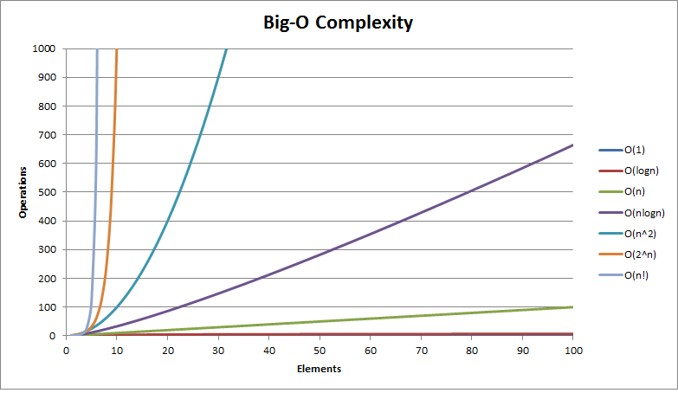
Big-O review
Relative to input n
Constants do not matter
O(3n)=O(n)
Higher order values dominate
O(n^2 + n) = O(n^2)

Slide 147
True/False
n + 5n³+8n⁴ = O(n)
n! + n² = O(nlogn)
2^{n} + nlogn = O(n!)

Slide 148
True/False
n + 5n³+8n⁴ = O(n) False
n! + n² = O(nlogn) False
2^{n} + nlogn = O(n!) True

Slide 149
True/False
1/n² + 5 = O(1/n)
logn + nlogn + log(logn) = Ω(logn)
2^{n} + n! = Ω(n^{n})

Slide 150
True/False
1/n² + 5 = O(1/n) False
logn + nlogn + log(logn) = Ω(logn) True
2^{n} + n! = Ω(n^{n}) False

Slide 151
True/False
n² + n + sqrt(n) = Ω(logn)
n² + n/4 + 6 = Θ(n³)
2^{n} + n = Θ(n)
1/n⁵⁰ + log32 = Θ(1)

Slide 152
True/False
n² + n + sqrt(n) = Ω(logn) True
n² + n/4 + 6 = Θ(n³) False
2^{n} + n = Θ(n) False
1/n⁵⁰ + log32 = Θ(1) True

Slide 153
What is big-O of the below code?
int num = 0;
for (int i = 0; i <= n*n; i = i+2) {
num = num + 2;
}

Slide 154
What is big-O of the below code?
int num = 0;
for (int i = 0; i <= n*n; i = i+2) {
num = num + 2;
}
ANSWER:
O(n²)

Slide 155
What is big-O of the below code?
int num = 1;
for (int i = 0; i < n; i = i+1) {
for (int j = 0; j <= i; j = j+1) {
num = num * 2;
}
}

Slide 156
What is big-O of the below code?
int num = 1;
for (int i = 0; i < n; i = i+1) {
for (int j = 0; j <= i; j = j+1) {
num = num * 2;
}
}
ANSWER:
O(n²)

Slide 157
What is big-O of the below code?
int num = 0;
for (int i = n*n; i > 0; i = i/2) {
for (int j = 1; j <= n; j = j+1) {
num = num + i;
}
}

Slide 158
What is big-O of the below code?
int num = 0;
for (int i = n*n; i > 0; i = i/2) {
for (int j = 1; j <= n; j = j+1) {
num = num + i;
}
}
ANSWER:
O(nlogn)
O(nlogn^2) ~ O(nlogn) due to log properties

Slide 159
What is big-O of the below code?
int num = 0;
for (int i = 0; i <= n*n; i = i+1) {
num = num + 1;
}
for (int i = 1; i <= n; i = i*2) {
for (int j = n; j >= 1; j = j/2) {
num = num + i;
}
}

Slide 160
What is big-O of the below code?
int num = 0;
for (int i = 0; i <= n*n; i = i+1) {
num = num + 1;
}
for (int i = 1; i <= n; i = i*2) {
for (int j = n; j >= 1; j = j/2) {
num = num + i;
}
}
ANSWER:
O(n²)

Slide 161
What is big-O of the below code?
void insert(int x, int n, int[] arr) {
for(int i = 0; i < n; i += 1) {
if(x < arr[i]) {
for(int j = n; j > i; j -= 1) {
arr[j] = arr[j - 1];
}
arr[i] = x;
return;
}
}
arr[n] = x;
}
public void isort(int[] arr) {
for(int i = 0; i < arr.length; i += 1) { insert(arr[i], i, arr)
}
}
Best insert: ?
Worst insert: ?
Worst isort: ?

Slide 162
What is big-O of the below code?
void insert(int x, int n, int[] arr) {
for(int i = 0; i < n; i += 1) {
if(x < arr[i]) {
for(int j = n; j > i; j -= 1) {
arr[j] = arr[j - 1];
}
arr[i] = x;
return;
}
}
arr[n] = x;
}
public void isort(int[] arr) {
for(int i = 0; i < arr.length; i += 1) { insert(arr[i], i, arr)
}
}
Best insert: O(n)
Worst insert: O(n)
Worst isort: O(n^2)
Taken from midterm #2!

Slide 163
Algorithms

Slide 164
BFS & DFS
https://visualgo.net/en/dfsbfs?slide=1

Slide 165
Trapped in a Maze!
col
col
col
col
0
1
2
3
row
0
row
1
row
S
2
row
Exit
3

Slide 166
Searching for the exit
SearchForTheExit
Initialize a task list to hold Squares as we search
Mark starting square as visited
Put starting square on task list
While task list is not empty
Remove square sq from task list
Mark sq as visited
If sq is the Exit, we're done!
For each of square's unseen neighbors (N, S, E, W):
Set neighbor's previous to sq
Add neighbor to task list
col
col
col
col
0
1
2
3
row
0
row
1
row
S
2
row
Exit
3

Slide 167
What will be the output?
What are the contents of the stack, from top (left) to bottom (right):
5, 10, 11, 5
5, 13, 10, 5
5, 10, 5
5, 11, 10
other
Consider doing the following operations on an initially empty stack, s:
s.push(5)
s.push(10)
s.push(11)
s.pop()
s.push(5)

Slide 168
What will be the output?
Consider doing the following operations on an initially empty stack, s:
s.push(5)
s.push(10)
s.push(11)
s.pop()
s.push(5)
What are the contents of the stack, from top (left) to bottom (right):
5, 10, 11, 5
5, 11, 10, 5
5, 10, 5
5, 11, 10
other

Slide 169
What will be the output?
1
2
3
4
How many stacks are needed to implement a queue? Consider the situation where no other data structure like arrays, linked list is available to you.

Slide 170
What will be the output?
1
2
3
4
How many stacks are needed to implement a queue? Consider the situation where no other data structure like arrays, linked list is available to you.

Slide 171
What will be the output?
What are the contents of the queue, from top (left) to bottom (right):
4, 10, 13, 5
10, 13, 5
4, 10, 5
5, 10, 4
other
Consider doing the following operations on an initially empty queue, q:
s.enqueue(4)
s.enqueue(10)
s.enqueue(13)
s.dequeue()
s.enqueue(5)

Slide 172
What will be the output?
What are the contents of the queue, from top (left) to bottom (right):
4, 10, 13, 5
10, 13, 5
4, 10, 5
5, 10, 4
other
Consider doing the following operations on an initially empty queue, q:
s.enqueue(4)
s.enqueue(10)
s.enqueue(13)
s.dequeue()
s.enqueue(5)

Slide 173
Breadth-first search (BFS) is an algorithm for traversing or searching tree or graph data structures. It starts at the tree root and explores the neighbor nodes first, before moving to the next level neighbors.
BFS can be implemented by using a queue.
Depth-first search (DFS) is an algorithm for traversing or searching tree or graph data structures. One starts at the root (selecting some arbitrary node as the root in the case of a graph) and explores as far as possible along each branch before backtracking.
DFS can be implemented by using a stack.

Slide 174
Say a reference to a Maze object is stored in a variable m. What expression would get the Square at row 3, column 5? * Mark only one
m.getRow(3).getCol(5)
m.contents[5][3]
m.contents[3][5]
m.getCol(5).getRow(3)

Slide 175
Say a reference to a Maze object is stored in a variable m. What expression would get the Square at row 3, column 5? * Mark only one
m.getRow(3).getCol(5)
m.contents[5][3]
m.contents[3][5]
m.getCol(5).getRow(3)

Slide 176
DFS, BFS, Stacks, and Queues
For more detailed examples of using stacks and queues to perform DFS and BFS, refer to the Week 3 Review linked in the course schedule on the course website. We perform both and show how Squares and the stack/queue is updated as the algorithm proceeds

Slide 177
Sorting

Slide 178
FILL IN THE BLANK
Selection Sort: Repeatedly find the ______ element and move it to the ______ of a ______ prefix of the array.
Insertion Sort: Repeatedly take the next element and insert it into the correct ______ position within a ______ prefix of the array.

Slide 179
FILL IN THE BLANK
Selection Sort: Repeatedly find the minimum element and move it to the end of a sorted prefix of the array.
Insertion Sort: Repeatedly take the next element and insert it into the correct ordered position within a sorted prefix of the array.

Slide 180
Given the array below after a call to partition, what indices have elements that could have been the partition (Assume partition chose a random element)
8 | 2 | 1 | 9 | 10 | 18 | 20 | 16 | 30
0 | 1 | 2 | 3 | 4 | 5 | 6 | 7 | 8
Notes:
Test on ideone:
/* package whatever; // don't place package name! */
import java.util.*;
import java.lang.*;
import java.io.*;
class Ideone {
public static void main (String[] args) throws java.lang.Exception
{
int [] x1 = {24};
int [] x2 = {37};
combine(x1, x2);
int [] x3 = {1,2,3};
int [] x4 = {3,4};
combine(x3, x4);
int [] x5 = {5,6};
int [] x6 = {5,6};
combine(x5, x6);
int [] x7 = {1,1};
int [] x8 = {2,2,2};
combine(x8 , x7);
int [] x9 = {1,3};
int [] x10 = {2,4};
combine(x9, x10);
}
public static String s(int[] arr) { return Arrays.toString(arr); }
/* Takes two arrays that are already sorted, and combines them into
a single array in sorted order */
public static int[] combine(int[] part1, int[] part2) {
int index1 = 0, index2 = 0;
int[] combined = new int[part1.length + part2.length];
while(index1 < part1.length && index2 < part2.length) {
if(part1[index1] < part2[index2]) {
combined[index1 + index2] = part1[index1];
index1 += 1;
}
else {
combined[index1 + index2] = part2[index2];
index2 += 1;
}
}
// while(index1 < part1.length) {
// combined[index1 + index2] = part1[index1];
// index1 += 1;
// }
// while(index2 < part2.length) {
// combined[index1 + index2] = part2[index2];
// index2 += 1;
// }
System.out.println(s(part1) + " + " + s(part2) + " -> " + s(combined));
return combined;
}
}

Slide 181
Given the array below after a call to partition, what indices have elements that could have been the partition (Assume partition chose a random element)
8 | 2 | 1 | 9 | 10 | 18 | 20 | 16 | 30
0 | 1 | 2 | 3 | 4 | 5 | 6 | 7 | 8
Indices: 3, 4, 8
Notes:
Test on ideone:
/* package whatever; // don't place package name! */
import java.util.*;
import java.lang.*;
import java.io.*;
class Ideone {
public static void main (String[] args) throws java.lang.Exception
{
int [] x1 = {24};
int [] x2 = {37};
combine(x1, x2);
int [] x3 = {1,2,3};
int [] x4 = {3,4};
combine(x3, x4);
int [] x5 = {5,6};
int [] x6 = {5,6};
combine(x5, x6);
int [] x7 = {1,1};
int [] x8 = {2,2,2};
combine(x8 , x7);
int [] x9 = {1,3};
int [] x10 = {2,4};
combine(x9, x10);
}
public static String s(int[] arr) { return Arrays.toString(arr); }
/* Takes two arrays that are already sorted, and combines them into
a single array in sorted order */
public static int[] combine(int[] part1, int[] part2) {
int index1 = 0, index2 = 0;
int[] combined = new int[part1.length + part2.length];
while(index1 < part1.length && index2 < part2.length) {
if(part1[index1] < part2[index2]) {
combined[index1 + index2] = part1[index1];
index1 += 1;
}
else {
combined[index1 + index2] = part2[index2];
index2 += 1;
}
}
// while(index1 < part1.length) {
// combined[index1 + index2] = part1[index1];
// index1 += 1;
// }
// while(index2 < part2.length) {
// combined[index1 + index2] = part2[index2];
// index2 += 1;
// }
System.out.println(s(part1) + " + " + s(part2) + " -> " + s(combined));
return combined;
}
}

Slide 182
Given the array below after a call to partition, what indices have elements that could have been the partition (Assume partition chose a random element)
1 | 2 | 3 | 4 | 5 | 6 | 7 | 8 | 9
0 | 1 | 2 | 3 | 4 | 5 | 6 | 7 | 8
Notes:
Test on ideone:
/* package whatever; // don't place package name! */
import java.util.*;
import java.lang.*;
import java.io.*;
class Ideone {
public static void main (String[] args) throws java.lang.Exception
{
int [] x1 = {24};
int [] x2 = {37};
combine(x1, x2);
int [] x3 = {1,2,3};
int [] x4 = {3,4};
combine(x3, x4);
int [] x5 = {5,6};
int [] x6 = {5,6};
combine(x5, x6);
int [] x7 = {1,1};
int [] x8 = {2,2,2};
combine(x8 , x7);
int [] x9 = {1,3};
int [] x10 = {2,4};
combine(x9, x10);
}
public static String s(int[] arr) { return Arrays.toString(arr); }
/* Takes two arrays that are already sorted, and combines them into
a single array in sorted order */
public static int[] combine(int[] part1, int[] part2) {
int index1 = 0, index2 = 0;
int[] combined = new int[part1.length + part2.length];
while(index1 < part1.length && index2 < part2.length) {
if(part1[index1] < part2[index2]) {
combined[index1 + index2] = part1[index1];
index1 += 1;
}
else {
combined[index1 + index2] = part2[index2];
index2 += 1;
}
}
// while(index1 < part1.length) {
// combined[index1 + index2] = part1[index1];
// index1 += 1;
// }
// while(index2 < part2.length) {
// combined[index1 + index2] = part2[index2];
// index2 += 1;
// }
System.out.println(s(part1) + " + " + s(part2) + " -> " + s(combined));
return combined;
}
}

Slide 183
Given the array below after a call to partition, what indices have elements that could have been the partition (Assume partition chose a random element)
1 | 2 | 3 | 4 | 5 | 6 | 7 | 8 | 9
0 | 1 | 2 | 3 | 4 | 5 | 6 | 7 | 8
ALL OF THEM!
Notes:
Test on ideone:
/* package whatever; // don't place package name! */
import java.util.*;
import java.lang.*;
import java.io.*;
class Ideone {
public static void main (String[] args) throws java.lang.Exception
{
int [] x1 = {24};
int [] x2 = {37};
combine(x1, x2);
int [] x3 = {1,2,3};
int [] x4 = {3,4};
combine(x3, x4);
int [] x5 = {5,6};
int [] x6 = {5,6};
combine(x5, x6);
int [] x7 = {1,1};
int [] x8 = {2,2,2};
combine(x8 , x7);
int [] x9 = {1,3};
int [] x10 = {2,4};
combine(x9, x10);
}
public static String s(int[] arr) { return Arrays.toString(arr); }
/* Takes two arrays that are already sorted, and combines them into
a single array in sorted order */
public static int[] combine(int[] part1, int[] part2) {
int index1 = 0, index2 = 0;
int[] combined = new int[part1.length + part2.length];
while(index1 < part1.length && index2 < part2.length) {
if(part1[index1] < part2[index2]) {
combined[index1 + index2] = part1[index1];
index1 += 1;
}
else {
combined[index1 + index2] = part2[index2];
index2 += 1;
}
}
// while(index1 < part1.length) {
// combined[index1 + index2] = part1[index1];
// index1 += 1;
// }
// while(index2 < part2.length) {
// combined[index1 + index2] = part2[index2];
// index2 += 1;
// }
System.out.println(s(part1) + " + " + s(part2) + " -> " + s(combined));
return combined;
}
}

Slide 184
Given the array below after a call to partition, what indices have elements that could have been the partition (Assume partition chose a random element)
1 | 10 | 9 | 8 | 7 | 6 | 5 | 4 | 3
0 | 1 | 2 | 3 | 4 | 5 | 6 | 7 | 8
Notes:
Test on ideone:
/* package whatever; // don't place package name! */
import java.util.*;
import java.lang.*;
import java.io.*;
class Ideone {
public static void main (String[] args) throws java.lang.Exception
{
int [] x1 = {24};
int [] x2 = {37};
combine(x1, x2);
int [] x3 = {1,2,3};
int [] x4 = {3,4};
combine(x3, x4);
int [] x5 = {5,6};
int [] x6 = {5,6};
combine(x5, x6);
int [] x7 = {1,1};
int [] x8 = {2,2,2};
combine(x8 , x7);
int [] x9 = {1,3};
int [] x10 = {2,4};
combine(x9, x10);
}
public static String s(int[] arr) { return Arrays.toString(arr); }
/* Takes two arrays that are already sorted, and combines them into
a single array in sorted order */
public static int[] combine(int[] part1, int[] part2) {
int index1 = 0, index2 = 0;
int[] combined = new int[part1.length + part2.length];
while(index1 < part1.length && index2 < part2.length) {
if(part1[index1] < part2[index2]) {
combined[index1 + index2] = part1[index1];
index1 += 1;
}
else {
combined[index1 + index2] = part2[index2];
index2 += 1;
}
}
// while(index1 < part1.length) {
// combined[index1 + index2] = part1[index1];
// index1 += 1;
// }
// while(index2 < part2.length) {
// combined[index1 + index2] = part2[index2];
// index2 += 1;
// }
System.out.println(s(part1) + " + " + s(part2) + " -> " + s(combined));
return combined;
}
}

Slide 185
Given the array below after a call to partition, what indices have elements that could have been the partition (Assume partition chose a random element)
1 | 10 | 9 | 8 | 7 | 6 | 5 | 4 | 3
0 | 1 | 2 | 3 | 4 | 5 | 6 | 7 | 8
Index 0 ONLY
Notes:
Test on ideone:
/* package whatever; // don't place package name! */
import java.util.*;
import java.lang.*;
import java.io.*;
class Ideone {
public static void main (String[] args) throws java.lang.Exception
{
int [] x1 = {24};
int [] x2 = {37};
combine(x1, x2);
int [] x3 = {1,2,3};
int [] x4 = {3,4};
combine(x3, x4);
int [] x5 = {5,6};
int [] x6 = {5,6};
combine(x5, x6);
int [] x7 = {1,1};
int [] x8 = {2,2,2};
combine(x8 , x7);
int [] x9 = {1,3};
int [] x10 = {2,4};
combine(x9, x10);
}
public static String s(int[] arr) { return Arrays.toString(arr); }
/* Takes two arrays that are already sorted, and combines them into
a single array in sorted order */
public static int[] combine(int[] part1, int[] part2) {
int index1 = 0, index2 = 0;
int[] combined = new int[part1.length + part2.length];
while(index1 < part1.length && index2 < part2.length) {
if(part1[index1] < part2[index2]) {
combined[index1 + index2] = part1[index1];
index1 += 1;
}
else {
combined[index1 + index2] = part2[index2];
index2 += 1;
}
}
// while(index1 < part1.length) {
// combined[index1 + index2] = part1[index1];
// index1 += 1;
// }
// while(index2 < part2.length) {
// combined[index1 + index2] = part2[index2];
// index2 += 1;
// }
System.out.println(s(part1) + " + " + s(part2) + " -> " + s(combined));
return combined;
}
}

Slide 186
Match the Sorting Algorithm!
static int[] combine(int[] p1, int[] p2) {...}
static int[] sort(int[] arr) {
int len = arr.length
if(len <= 1) { return arr; }
else {
int[] p1 = Arrays.copyOfRange(arr, 0, len / 2);
int[] p2= Arrays.copyOfRange(arr, len / 2, len);
int[] sortedPart1 = sort(p1);
int[] sortedPart2 = sort(p2);
int[] sorted = combine(sortedPart1, sortedPart2);
return sorted;
}
}
static void sort(int[] arr) {
for(int i = 0; i < arr.length; i += 1) {
int minIndex = i;
for(int j = i; j < arr.length; j += 1) {
if(arr[minIndex] > arr[j]) { minIndex = j; }
}
int temp = arr[i];
arr[i] = arr[minIndex];
arr[minIndex] = temp;
}
}
static void sort(int[] arr) {
for(int i = 0; i < arr.length; i += 1) {
for(int j = i; j > 0; j -= 1) {
if(arr[j] < arr[j-1]) {
int temp = arr[j-1];
arr[j-1] = arr[j];
arr[j] = temp;
}
else { break; }
}
}
}
static int partition(String[] array, int l, int h) {...}
static void sort2(String[] array, int low, int high) {
if(high - low <= 1) { return; }
int splitAt = partition(array, low, high);
sort2(array, low, splitAt);
sort2(array, splitAt + 1, high);
}
public static void sort1(String[] array) {
sort2(array, 0, array.length);
}

Slide 187
Match the Sorting Algorithm!
static int[] combine(int[] p1, int[] p2) {...}
static int[] mergeSort(int[] arr) {
int len = arr.length
if(len <= 1) { return arr; }
else {
int[] p1 = Arrays.copyOfRange(arr, 0, len / 2);
int[] p2= Arrays.copyOfRange(arr, len / 2, len);
int[] sortedPart1 = sort(p1);
int[] sortedPart2 = sort(p2);
int[] sorted = combine(sortedPart1, sortedPart2);
return sorted;
}
}
static void selectionSort(int[] arr) {
for(int i = 0; i < arr.length; i += 1) {
int minIndex = i;
for(int j = i; j < arr.length; j += 1) {
if(arr[minIndex] > arr[j]) { minIndex = j; }
}
int temp = arr[i];
arr[i] = arr[minIndex];
arr[minIndex] = temp;
}
}
Merge
Selection
static void insertionSort(int[] arr) {
for(int i = 0; i < arr.length; i += 1) {
for(int j = i; j > 0; j -= 1) {
if(arr[j] < arr[j-1]) {
int temp = arr[j-1];
arr[j-1] = arr[j];
arr[j] = temp;
}
else { break; }
}
}
}
static int partition(String[] array, int l, int h) {...}
static void quickSort(String[] array, int low, int high) {
if(high - low <= 1) { return; }
int splitAt = partition(array, low, high);
quickSort(array, low, splitAt);
quickSort(array, splitAt + 1, high);
}
public static void sort(String[] array) {
sort2(array, 0, array.length);
}
Insertion
Quick

Slide 188
FILL IN THE BLANK
________ (algorithm) finds the minimum element in a list and moves it to the end of a sorted prefix in the list.
________ (algorithm) repeatedly takes the next element in a list inserts it into the correct ordered position within a sorted prefix of the list.

Slide 189
FILL IN THE BLANK
Selection sort (algorithm) finds the minimum element in a list and moves it to the end of a sorted prefix in the list.
Insertion sort (algorithm) repeatedly takes the next element in a list inserts it into the correct ordered position within a sorted prefix of the list.

Slide 190
FILL IN THE BLANK
________ (algorithm) repeatedly splits a list of elements at a certain index, where all elements to the left are <= and all elements to the right are >=. Then, the single elements at the end are already in order to be recombined.
________ (algorithm) repeatedly splits a list of elements in half until we have single elements. Then, the single elements at the end are compared by value and recombined to put them in order.

Slide 191
FILL IN THE BLANK
Quick sort (algorithm) repeatedly splits a list of elements at a certain index, where all elements to the left are <= and all elements to the right are >=. Then, the single elements at the end are already in order to be recombined.
Merge sort (algorithm) repeatedly splits a list of elements in half until we have single elements. Then, the single elements at the end are compared by value and recombined to put them in order.

Slide 192
FILL IN THE BLANK
 | Insertion | Selection | Merge | Quick
Best case time | O(____) | O(____) | O(____) | O(____)
Worst case time | O(____) | O(____) | O(____) | O(____)
Key operations | swap(a, j, j-1) (until in the right place) | swap(a, i, indexOfMin) (after finding minimum value) | l = copy(a, 0, len/2) r = copy(a, len/2, len) ls = sort(l) rs = sort(r) merge(ls, rs) | p = partition(a, l, h) sort(a, l, p) sort(a, p + 1, h)

Slide 193
FILL IN THE BLANK
 | Insertion | Selection | Merge | Quick
Best case time | O(n) | O(n²) | O(n*logn) | O(n*logn)
Worst case time | O(n²) | O(n²) | O(n*logn) | O(n²)
Key operations | swap(a, j, j-1) (until in the right place) | swap(a, i, indexOfMin) (after finding minimum value) | l = copy(a, 0, len/2) r = copy(a, len/2, len) ls = sort(l) rs = sort(r) merge(ls, rs) | p = partition(a, l, h) sort(a, l, p) sort(a, p + 1, h)

